Slide 1
Supply chain sustainability analysis
Ian Cedric Io
Created in R & Tableau

Slide 2
AGENDA
Problem
Exploratory Data Analysis
Insights
Recommendations

Slide 3
Problem
Which orders should be prioritised?
Issue: High number of item complexity (557 different items)
Tool: Pareto Analysis – according to total value ($) and number of items

Slide 4
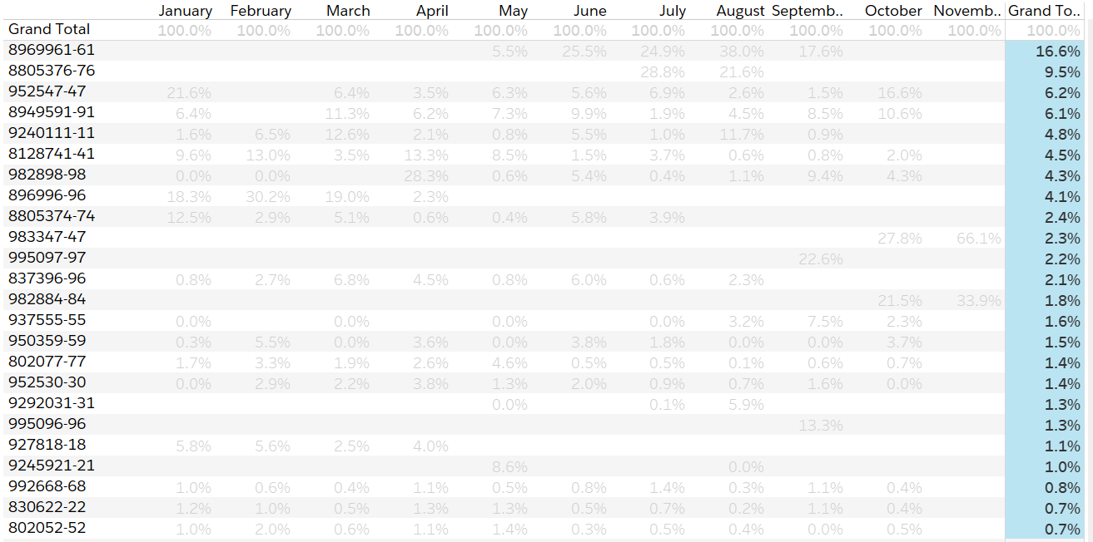
Which items should we prioritize?
Across all months, Class A items represent
79.4% of total value
24 (top 5%) out of 557 items
*However, our analysis would need to be validated with month-to-month breakdown due to seasonality trends

Slide 5
PRESENTATION TITLE
Mirjam Nilsson​

Slide 6
AGENDA
Introduction​
Primary goals
​Areas of growth
Timeline
​Summary​

Slide 7
Introduction
At Contoso, we empower organizations to foster collaborative thinking to further drive workplace innovation. By closing the loop and leveraging agile frameworks, we help business grow organically and foster a consumer-first mindset.

Slide 8
PRIMARY GOALS
Annual revenue growth

Slide 9
AREAS OF GROWTH
 | B2B | Supply chain | ROI | E-commerce
Q1 | 4.5 | 2.3 | 1.7 | 5.0
Q2 | 3.2 | 5.1 | 4.4 | 3.0
Q3 | 2.1 | 1.7 | 2.5 | 2.8
Q4 | 4.5 | 2.2 | 1.7 | 7.0

Slide 10
BUSINESS OPPORTUNITIES ARE LIKE BUSES. THERE'S ALWAYS ANOTHER ONE COMING.
“
”
Richard Branson

Slide 11




MEET OUR TEAM
TAKUMA HAYASHI
MIRJAM NILSSON
FLORA BERGGREN​
RAJESH SANTOSHI​
President
Chief Executive Officer
Chief Operations Officer
VP Marketing

Slide 12








MEET OUR Extended TEAM
TAKUMA HAYASHI
MIRJAM NILSSON
FLORA BERGGREN​
RAJESH SANTOSHI​
President
Chief Executive Officer
Chief Operations Officer
VP Marketing
GRAHAM BARNES
ROWAN MURPHY
ELIZABETH MOORE
ROBIN KLINE
VP Product
SEO Strategist
Product Designer
Content Developer

Slide 13





PLAN FOR PRODUCT LAUNCH
PLANNING
MARKETING
DESIGN
STRATEGY
LAUNCH
Synergize scalable e-commerce
Disseminate standardized metrics
Coordinate e- business applications
Foster holistically superior methodologies
Deploy strategic networks with compelling e- business needs

Slide 14
TIMELINE
SEP 20XX
NOV 20XX
JAN 20XX
MAR 20XX
MAY 20XX
Synergize scalable e-commerce
Disseminate standardized metrics
Coordinate e- business applications
Foster holistically superior methodologies
Deploy strategic networks with compelling e- business needs

Slide 15
AREAS OF FOCUS
B2B MARKET SCENARIOS
CLOUD-BASED OPPORTUNITIES
Develop winning strategies to keep ahead of the competition
Capitalize on low-hanging fruit to identify a ballpark value
Visualize customer directed convergence
Iterative approaches to corporate strategy
Establish a management framework from the inside

Slide 16



HOW WE GET THERE
ROI
NICHE MARKETS
SUPPLY CHAINS
Envision multimedia-based expertise and cross-media growth strategies
Visualize quality intellectual capital
Engage worldwide methodologies with web-enabled technologies
Pursue scalable customer service through sustainable strategies
Engage top-line web services with cutting-edge deliverables
Cultivate one-to-one customer service with robust ideas
Maximize timely deliverables for real-time schemas

Slide 17
SUMMARY
At Contoso, we believe in giving 110%. By using our next-generation data architecture, we help organizations virtually manage agile workflows. We thrive because of our market knowledge and great team behind our product. As our CEO says, "Efficiencies will come from proactively transforming how we do business."

Slide 18
THANK YOU
Mirjam Nilsson​
mirjam@contoso.com
www.contoso.com

